Slide 1
SOS Application
By Group 9
Kanika Makhija (001835101) Mrinal Sharma (001448287) Vishaka Varma Vimal (001448330) Sumit Anglekar (001475969)

Slide 2
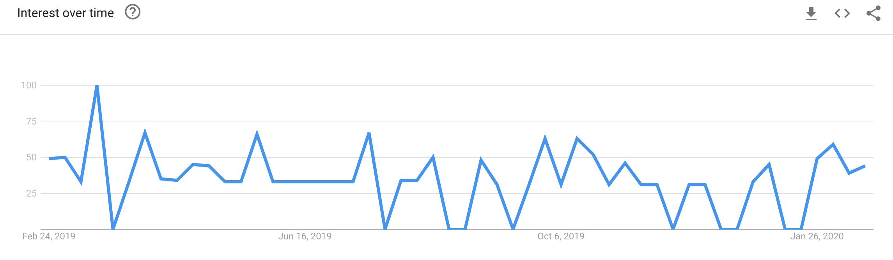
Existing design
Every year people suffer from a lot of mis happenings because of lack of emergency services available and delayed response time
There are a lot of applications available in the market which are paid. Such applications should be made free of cost for the all the users/customers
Also, the applications are not user-friendly which makes it difficult for the user to avail the service on time

Slide 3
Mid-term Summary
Analyzed the existing SOS applications and researched on their flaws and how it can be improved
Created business objectives and user needs
Created a simple and intuitive application by anticipating user needs
Created a role-based police tracking and management service
A police officer could create an investigation by adding images, descriptions for an emergency request. He could also communicate with the other police officers and admin
Implemented real time locations and availability of on duty police offers
Implemented real time notifications for any updates regarding an investigation
The admin can assign investigations and communicate with the police officer through our application

Slide 4

FLAWS
Too many questions asked : Need to answer to a huge questionnaire before finally contacting emergency
Color Scheme: The application has loud colors which distracts the users from the application and creates a negative mood and perception
Overwhelming: Contacting emergency services if often overwhelming
Platform: No single platform where users can request for emergency services and the police can manage investigations with the help of technology

Slide 5
Improvements
Onboarding: The app includes joyride onboarding, tooltips and video onboarding to make the user make comfortable and help him getting an insight of the app
Authentication & Security: We have implemented 2FA and Face ID authentication to enhance user security and easy login
Monochrome or limited color palette: Minimal set of colors doesn't distract users with too much variety. Simple and subtle colors make every word readable and easier on the eyes
Embedded Maps: The app consists of embedded maps which helps in easier location tracking. It enables the user to easily zoom and navigate with an interactive map and they can track the location of police.
Role- based Police Tracking System: App is designed for assigning and creating investigation tasks

Slide 6
Skeleton plane
Determines the visual form on the screen, presentation and arrangement of all elements that makes us interact with the functionality of the system
How the user moves through the information
How information is presented to make it coherent, articulate and effective
Split into three components Interface Design, Navigation Design, & Information Design

Slide 7
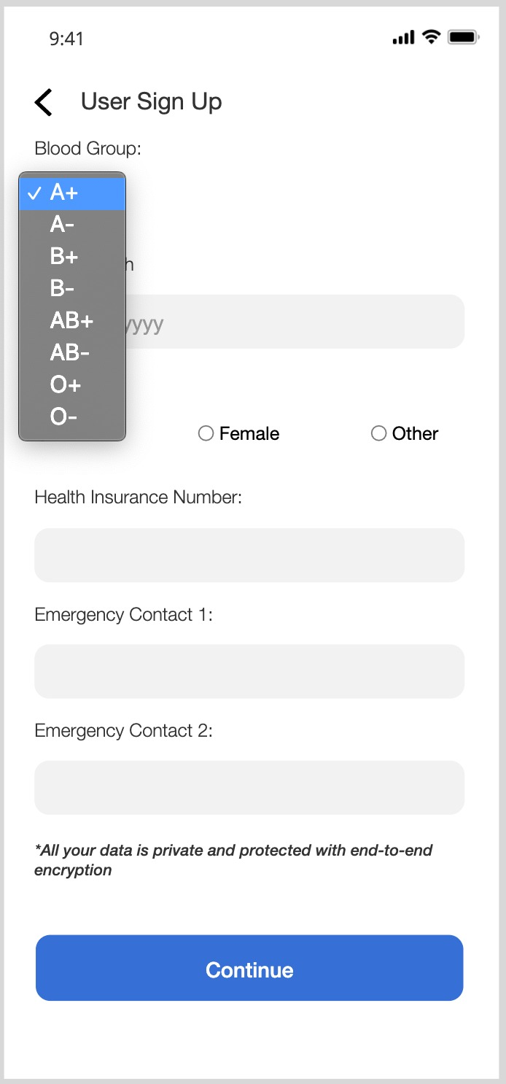
Interface design
Presenting and arranging interface elements to enable users to interact with the functionality of the system
Selecting the right interface elements for the task the user is trying to accomplish and arranging them on the screen in a way that will be readily understood and easily used
Successful interfaces are those in which users immediately notice the important stuff

Slide 8
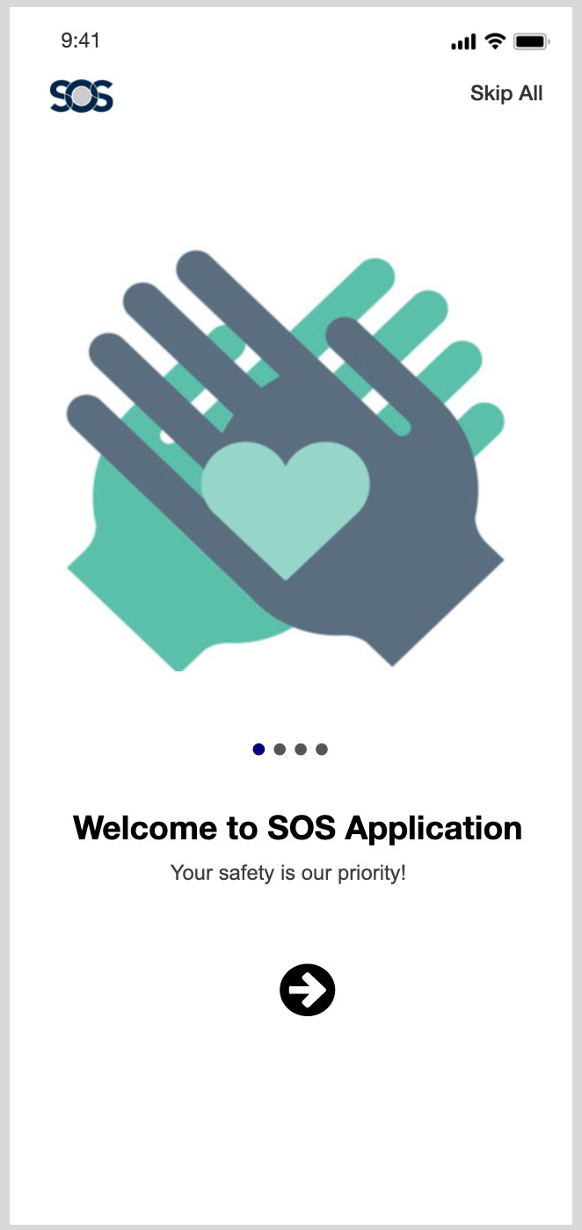
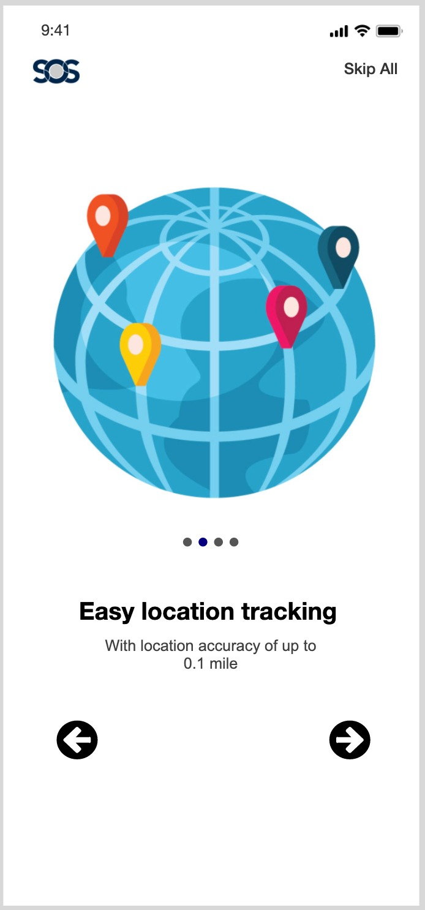
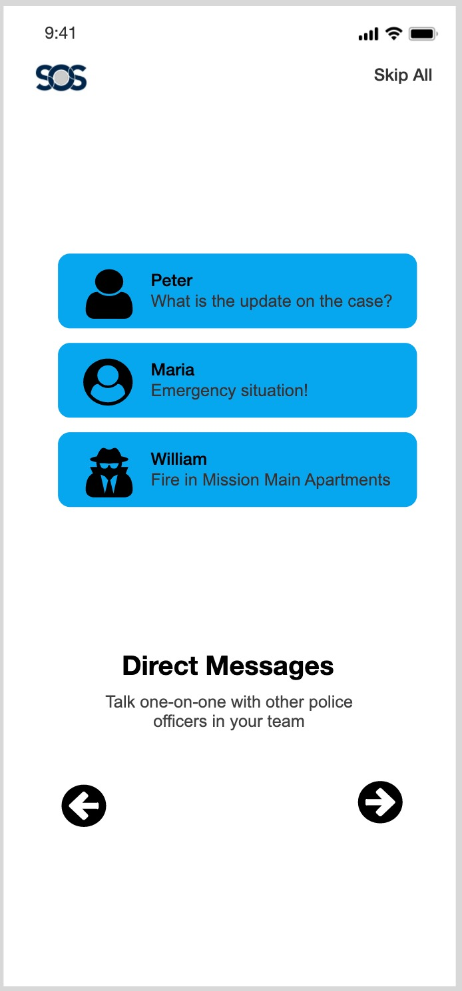
Navigation Design
How to navigate through the information using the interface
Provide users with a means for getting from one point to another on the site

Slide 9
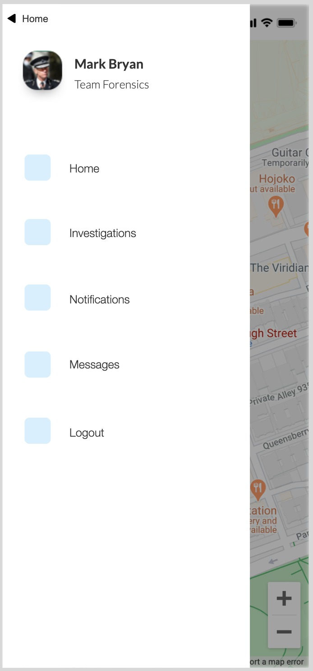
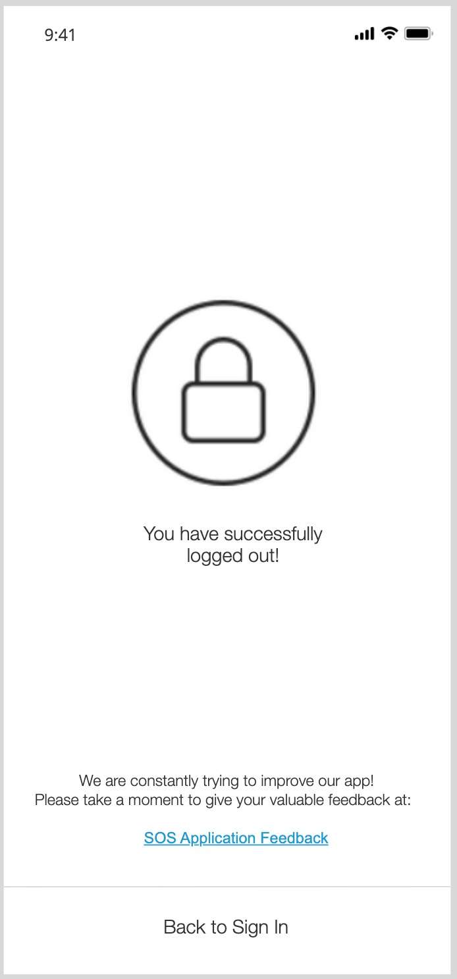
NAVIGATION DESIGN
Global navigation provides access to the broad sweep of the entire site
Local navigation provides users with access to what’s “nearby” in the architecture
Also implemented remote navigation tools such as site map
Contextual navigation embedded in the content of the page itself

Slide 10
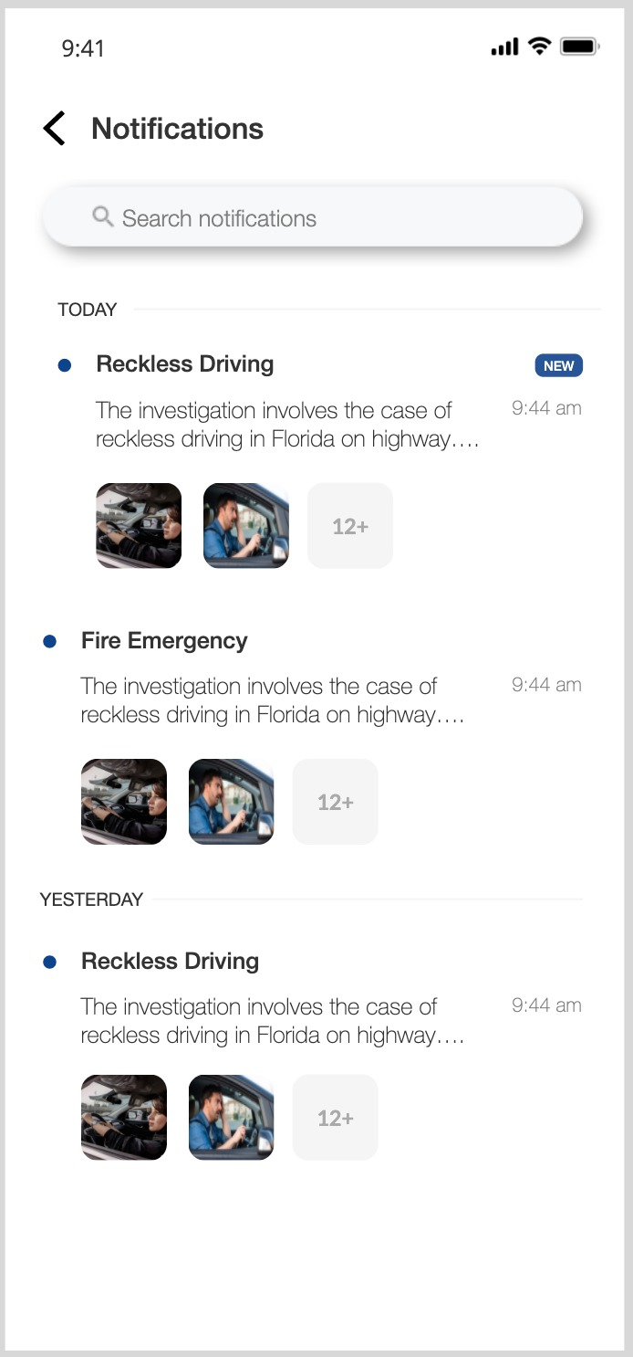
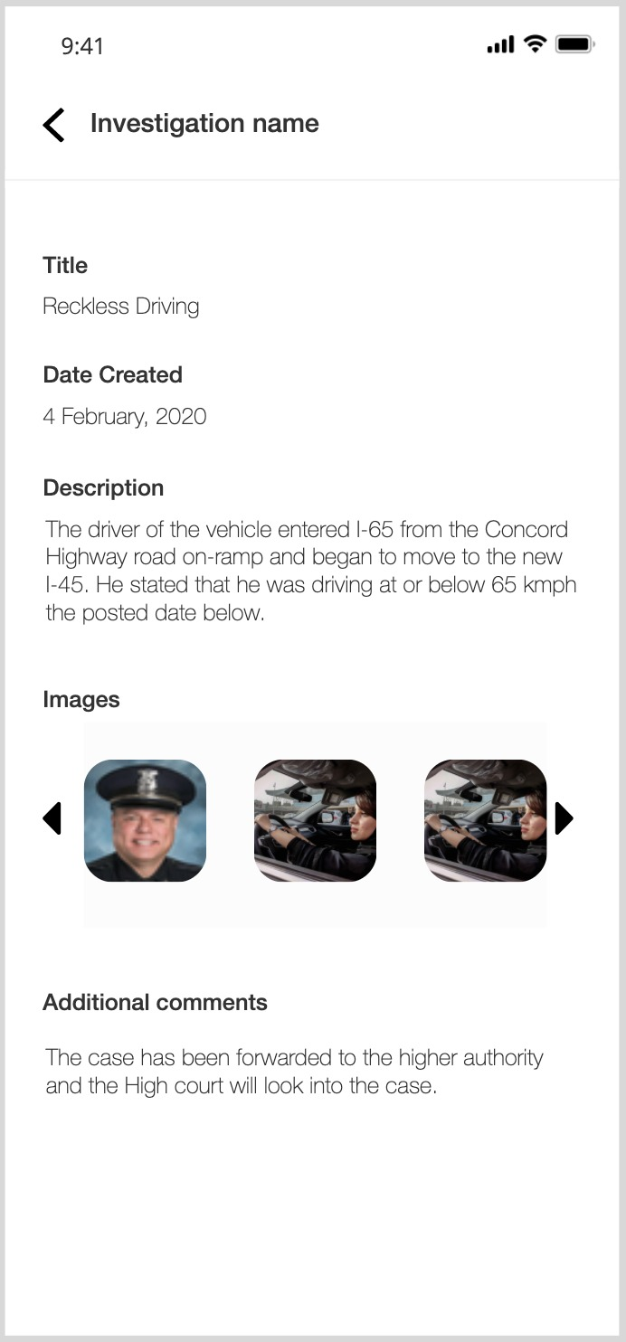
Information Design
Defines the presentation of information in a way that facilitates understanding
Placement and prioritization of informational components
Information design comes down to making decisions about how to present information so that people can use it or understand it more easily

Slide 11
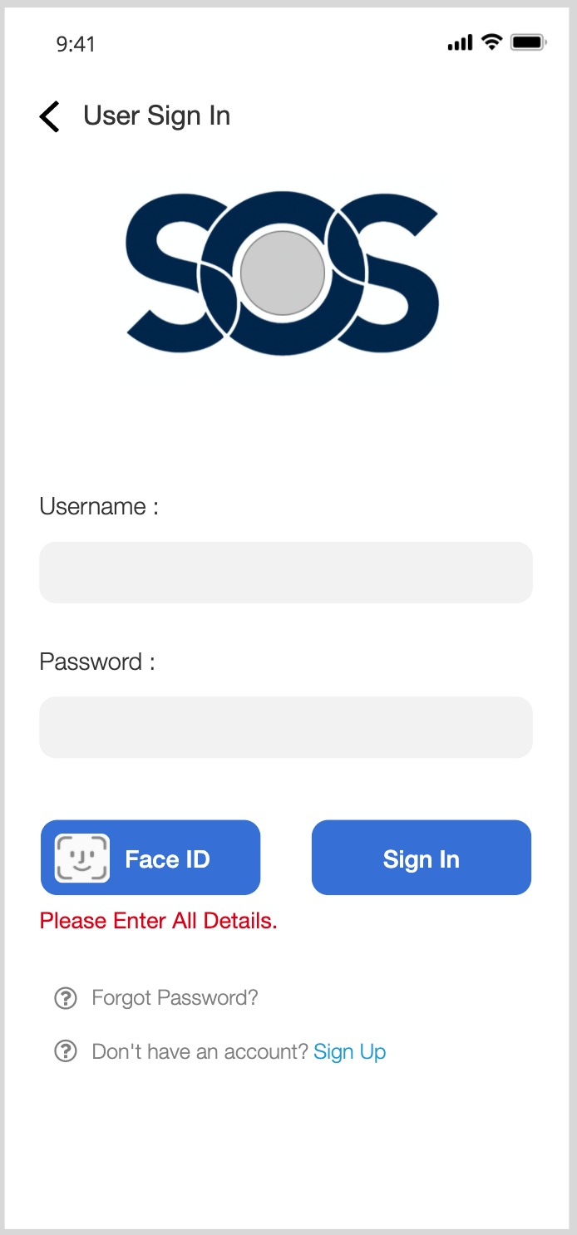
Surface plane
Total of all the work and decisions we have made. It determines how does the product will look like
Use of contrast
Maintained uniformity throughout the application- We have used same color pallete and font throughout the application.
Kept the sizes of elements uniform. Example , all the graphic buttons are of the same height thus avoiding a cluttered layout

Slide 12



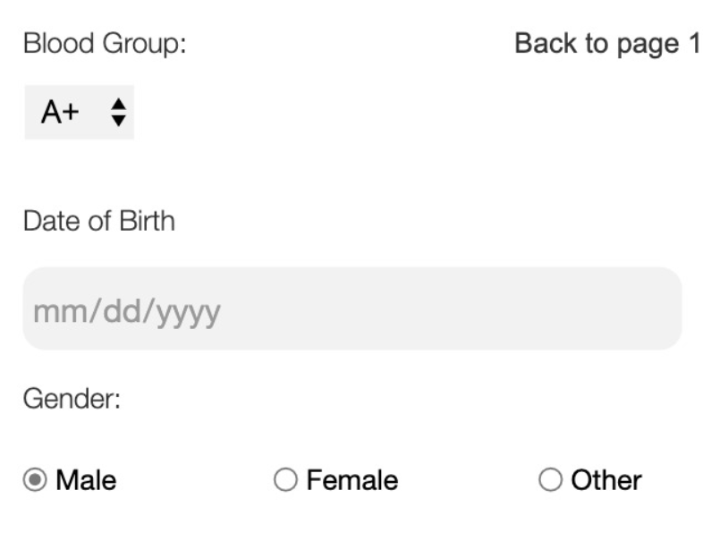
Google material design
iOS buttons such as 'Add Primary' and 'Add Secondary' buttons, toggle bar to turn off/on different settings in the app, search bar
Buttons: radio buttons, dropdown

Slide 13
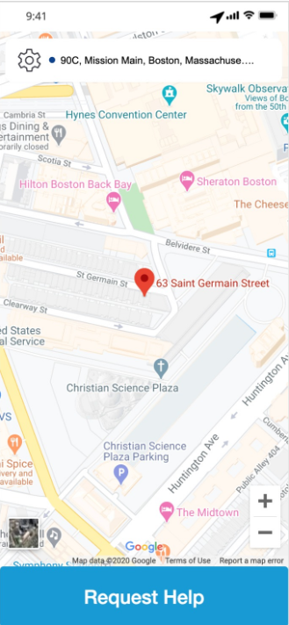
Embedded Maps: helps in easier location tracking. It enables the user to easily zoom and navigate with an interactive map and they can track the location of police.

Slide 14
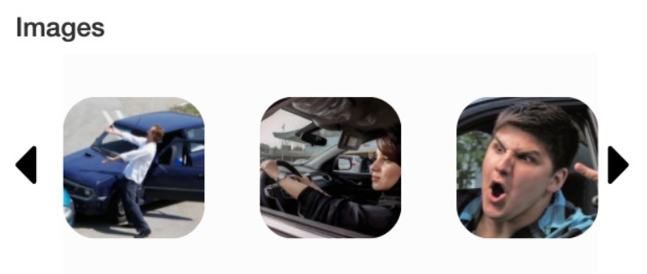
Image Slider: represents a more fun and engaging input method compared with other UI controls
Typography: We have used Helvetica Neue which is the default iOS font
Logical Resolution: 375*812 pixels
Display Size: 5.8'' display screen size

Slide 15
Ux Principles
Hierarchy- how content is organized across the app or site.
We have top level of the hierarchy as a primary navigation menu that includes the main sections. As you will click on each item in the menu, you will reach the specific sections in the application

Slide 16

Ux Principles
Design in phases-
Ideation – Designed sketches
Concept validation - Wireframes
Refinement- Prototype
Usability- Design

Slide 17
Ux Principles
Consistency
Users expect products to share some similarities with other products they regularly use. We followed iOS design conventions and conventions
We made sure that it is easy to learn even for a first time user based on the experience of using iOS

Slide 18
Ux Principles
Accessibility
Design should be usable for as many people as possible
For people with disablities we have introduced activation on 'button' functionality. If a user presses the power button 3 times simultaneously the SOS app will be triggered.

Slide 19
Ux Principles
User Context
The emotional state of a user would impact how patient or impatient she might be when interacting with the user interface of our application
Less in More
Simplicity as opposed to clutter or over-decoration in design.
Reduce the operational and cognitive costs of the users

Slide 20
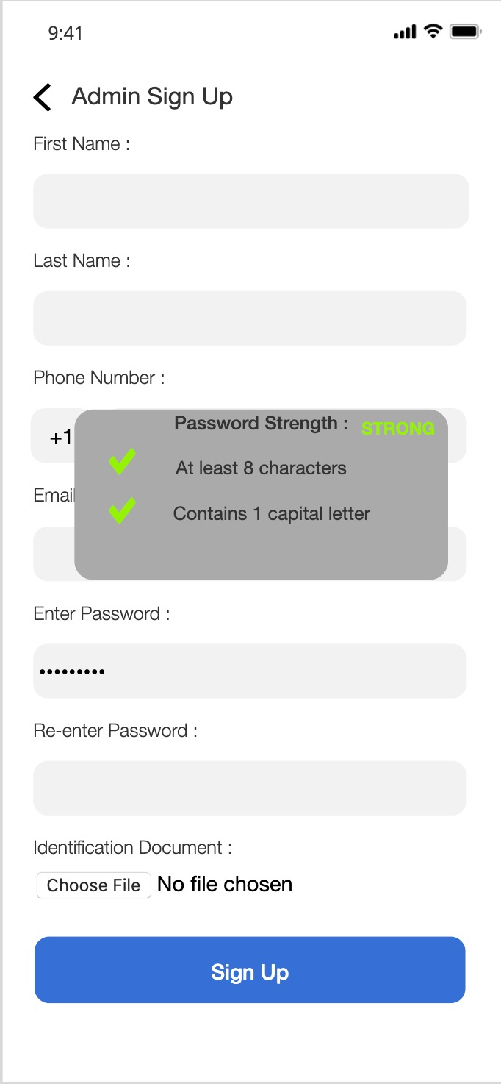
Ux Principles
Feedback from design
Design should be interactive by nature.
When a user performs an action for example in this example choosing a strong password.
He’ll need a response from the product to understand that his entry has been received and is valid

Slide 21
QA and Testing
Test Cases:
Sign Up
Sign In
Log In
Types of Testing:
Manual Testing
Automation Testing (Selenium, JUnit)

Slide 22
UX Research methods
Customer Feedback: open-ended and/or close-ended information provided by a self-selected sample of users, often through a feedback link, button, form, or email
Concept Testing: It determine the value of concept (an idea or a thought) features and benefits. Knowing what your customers like or dislike about your new concept can guide future development and understand user needs better.

Slide 23
UX Research methods
Concept Testing:
It determine the value of concept (an idea or a thought) features and benefits. Knowing what your customers like or dislike about your new concept can guide future development and understand user needs better.
Concept Testing can be conducted in two different ways:
Quantitative Research:
We are conducting market survey in our app to get the required user feedback.
Qualitative Research:
We conducted interviews with individual and focused group and took necessary feedbacks to restructure our prototype or implementation in the given scenario.
This helped us gain knowledge and understand consumer behavior while using our product.

Slide 24
UX RESEARCH METHODS
Focus Group:
Focus group can be any individual who is under distress or need emergency assistance.
While carefully studying any focus group, we need to understand their primary requirements and make their process as easy as possible.
We studied the focus group needs and concluded there wasn't any app which interconnected both Users and Police on a single platform.
Our app provided this common baseline platform which can help these two roles interact with each other.
Further studying the user needs, we provided the user with necessary emergency assistance or service in a single click (Volume and power button, triggering the app for an emergency call) and sending a notification to the admins who would redirecting the case immediately to the officer on duty.

Slide 25
UX Research methods
A/B Testing
A/B testing is the practice of showing two variants of the same application design to different segments of users at the same time and comparing which variant drives more conversions
We used different sets/sizes of buttons in our application and compared the user experience with one design with the other
Earlier had a simple home screen and then added an interactive map and compared the two designs. The latter was found out to be a rich user experience
Decision to use the current font was also made in a similar way. By placing two different fonts in the identical design and then getting feedback and opinions on which is better for user readability

Slide 26
UX Research methods
A/B Testing
A/B testing is the practice of showing two variants of the same application design to different segments of users at the same time and comparing which variant drives more conversions
We used different sets/sizes of buttons in our application and compared the user experience with one design with the other
Earlier had a simple home screen and then added an interactive map and compared the two designs. The latter was found out to be a rich user experience
Decision to use the current font was also made in a similar way. By placing two different fonts in the identical design and then getting feedback and opinions on which is better for user readability

Slide 27
UX Research methods
True-Intent Studies:
Users and their goal or intention is upon entering the application
Measures their subsequent behavior
Whether they were successful in achieving their goal upon exiting the site
Example questions:-
Who’s visiting?
Why are they coming?
What do they like or dislike?
How well do they succeed?

Slide 28
UX RESEARCH METHODS
Survey:
In our app we are conducting required surveys to understand user need from their perspective.
This would avoid us assuming the needs of the target audience by ourselves.
Real-time Responses
Reach all Demographics

Slide 29
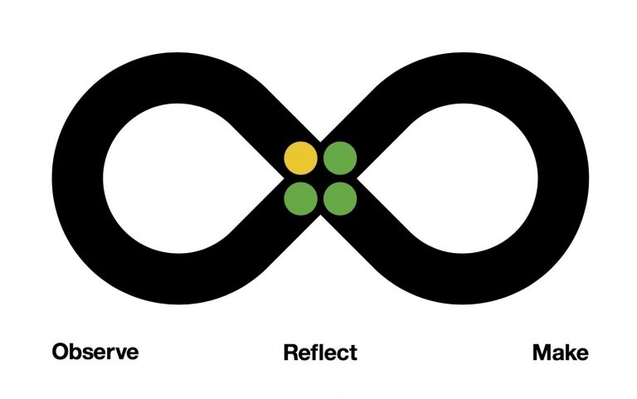
IBM DESIGN THINKING
Observe: Carefully formulated user requirements and what is of utmost necessary in an emergency situation
Reflect: Came up with a consensus and developed an action plan on how we are implementing the use cases in our design in an efficient and organized way
Make: Communicated our ideas, worked on prototype concepts and drove outcomes. Final product is a reflection of our ideas and is in coherence of the user needs for an emergency SOS service

Slide 30

IBM DESIGN THINKING
Hills -- turn human needs into project goals by aligning a whole-team around a common understanding of success.
Our common understanding of success through this application is that it should put the user first and it should reflect an enriching design experience. Our project goal has been met by working as a team with well-defined project goals.
Playbacks -- safe space for team members. We regularly voiced our opinion concerning our effort. Regularly identified alignment and misalignment about what we intend to deliver. Kept in mind the perspective of an end user based on what we observed, reflected and made
Sponser Users -- took regular feedback and opinion from users who are beyond ou team. Our aim with such interactions was to close the gap between our assumptions and their reality

Slide 31

Style guide - branding
Logo: We have designed a simple logo that clearly shows the letters SOS. The logo has a subtle hidden pattern in it. The 'O' in the logo is made to resemble a rescue tube which is used by lifeguards at pools/seas to save people in need.

Slide 32
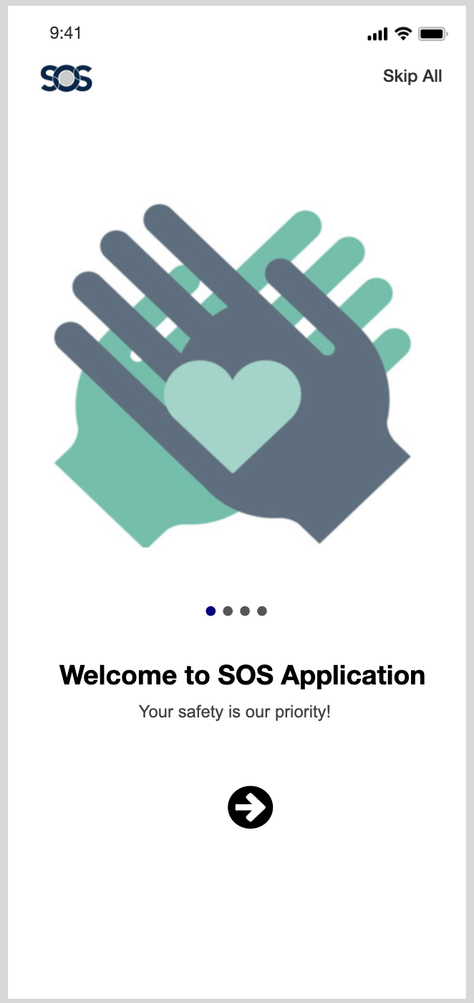
Onboarding techniques
Joy Ride Onboarding: helps the user to get right into the application, drawing their attention to key features with subtle visual cues. When the user interacts with these cues, they get tips on using the feature

Slide 33
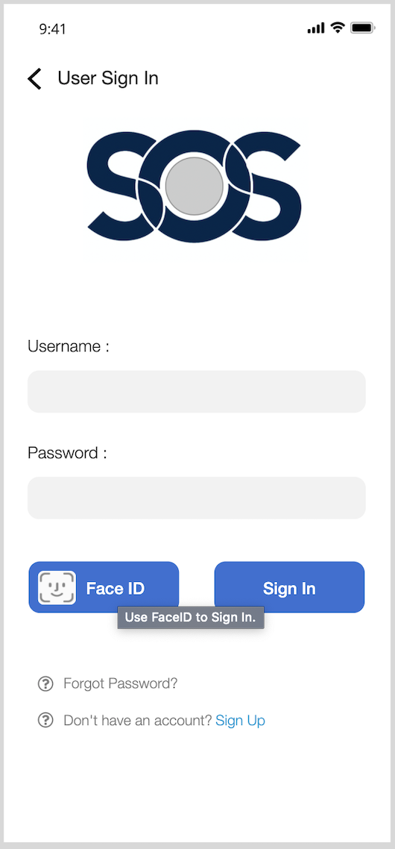
Onboarding techniques
Tooltips: help direct attention toward a specific item or action

Slide 34
Onboarding techniques
Video onboarding: gives a virtual tour of the application to the user

Slide 35

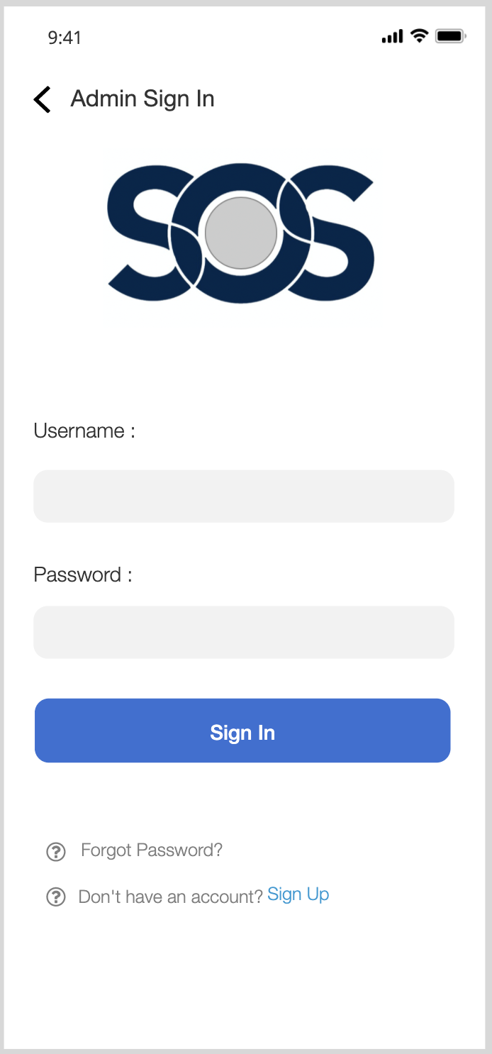
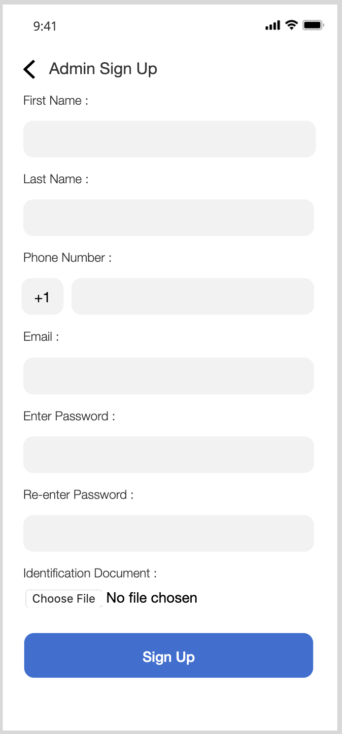
High fidelity mockup using axure

Slide 36
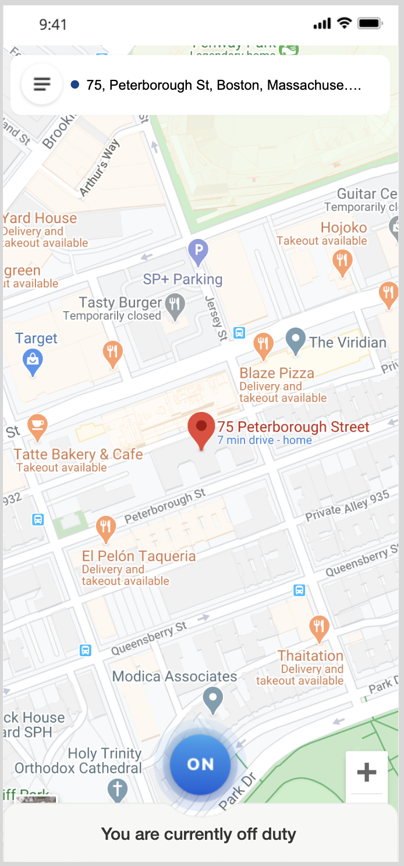
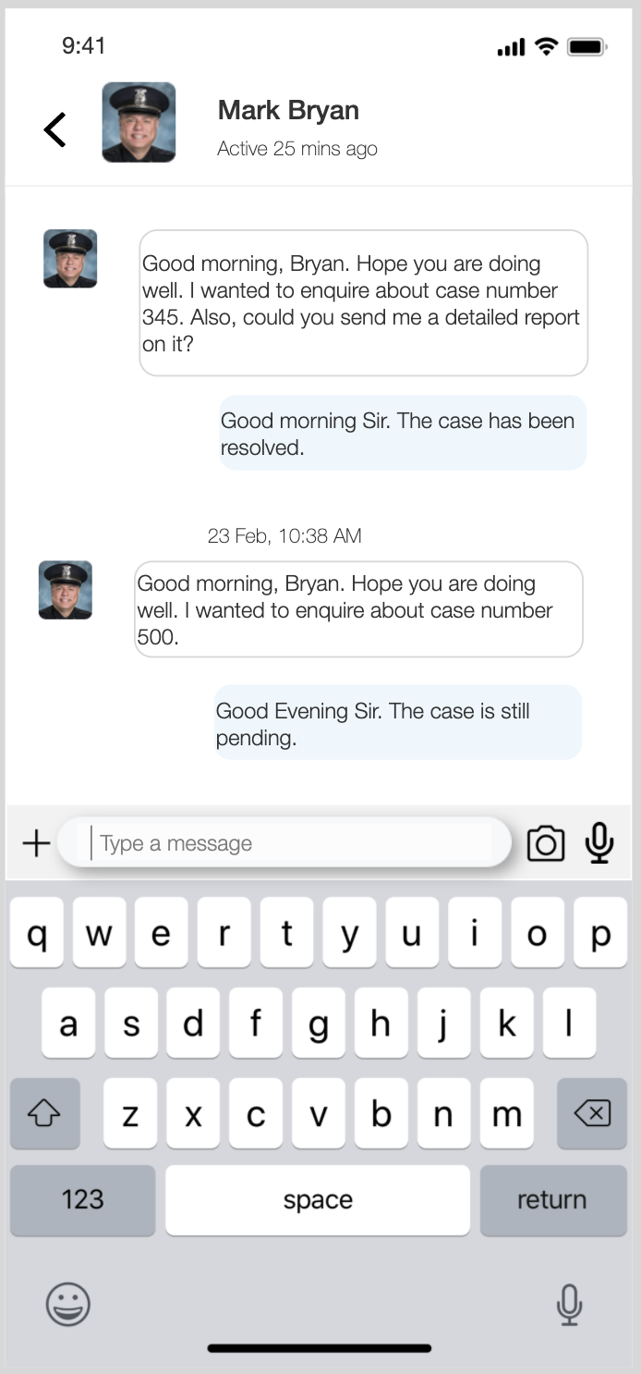
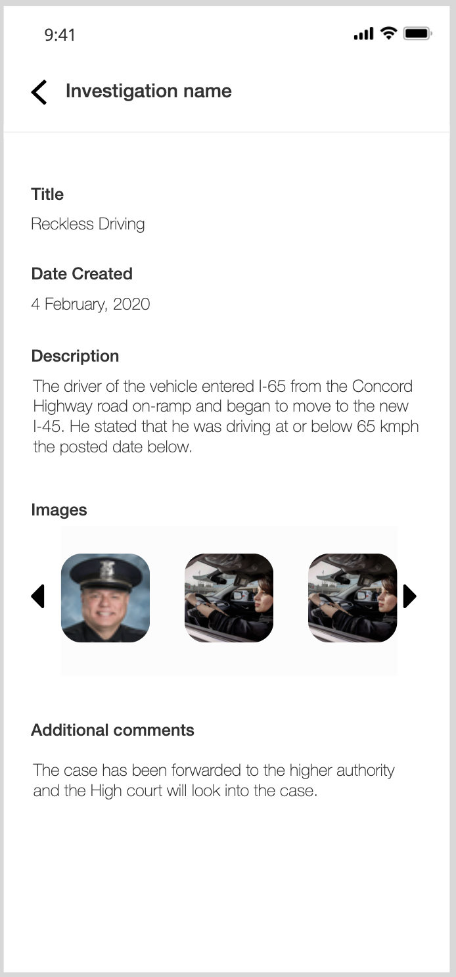
High fidelity mockup using axure

Slide 37
Extra features
Onboarding – Joyride, tooltip, video
Feedback report generated from User Survey
Password Strength Checker
Error Handling and Validations
Embedded Maps with street view and Earth view
Animations on swipe left and swipe right
Face ID on user Sign In
Image Slider
File attachment feature

Slide 38
Teamwork/collaboration
We had multiple brainstorming sessions where we gathered all the pain points, requirements, scope, design elements and all other metrics required to build the application
We have divided the application into 3 sections: Admin,Police Officer,User
We evenly divided a total of 43 screens in Axure amongst all 4 team members
All the team members also contributed in creating the power point presentation
All team members contributed in Selenium Testing

Slide 39
THANK YOU

